Slide 1

DT262- Execute Bots Rapidly in SAP S/4HANA Cloud with SAP Build Process Automation

Slide 2
Agenda
SAP Build Process Automation
Solution Overview
SAP S/4HANA Cloud Out-of-Box Prebuilt Content
Hands-on Exercise - Extend SAP S/4HANA Prebuilt Content with Workflow
Hands-on Exercise Flow

Slide 3

SAP Build Process Automation

Slide 4













Introducing SAP Build Process Automation Capabilities: citizen automation for line-of-business builders
SAP Build Process Automation
Process manager Process mining
Citizen app dev
Process
Form
Intelligence
Task center
Integrated process insights and customer sentiments
Experience management
Advanced workflow
Business rules
Automations
Process visibility
Pro-code app dev
New citizen automation user experience (process builder, forms builder)
All advanced workflow management capabilities available (rules, process visibility, process flexibility, AI)
Embedded RPA capabilities to readily combine bot automations with workflows
Content and reusable artifacts (such as bots, workflow components, process steps, actions)
Unified launchpad and task center for citizen developer applications and automations

Slide 5
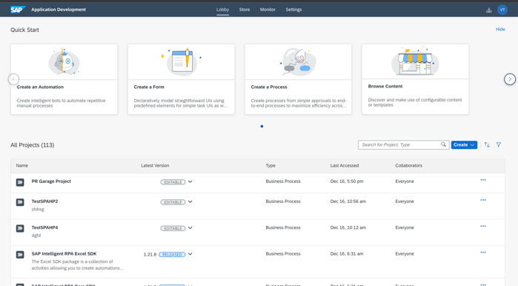
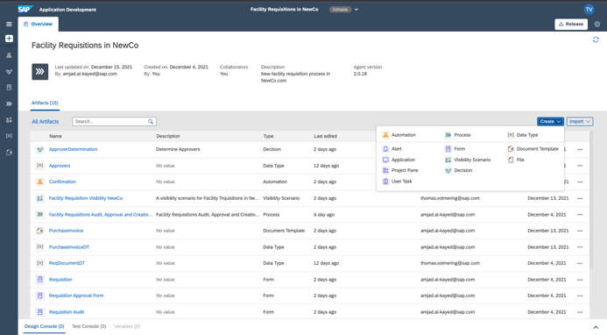
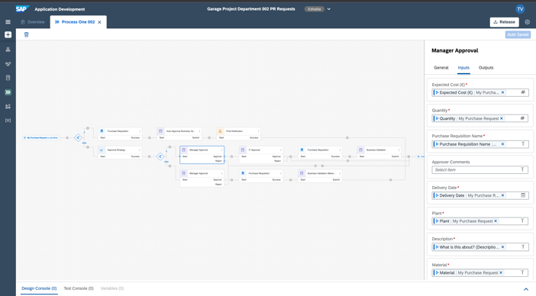
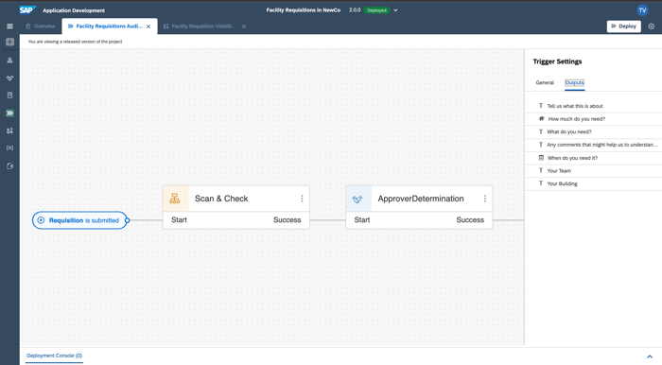
Citizen developer workflow and automation in ONE product experience
One Lobby across Process Automation & Application Development
One Process Project with a simple life cycle and fast time to value across all artifacts
Lobby
Project
One Process Builder combining Workflow steps with Automations in a simple intuitive language
Embedded AI capabilities with immersive modeling experience to add intelligent automations into process
Process
Process with intelligent Automation

Slide 6


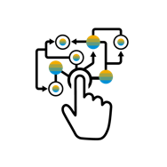
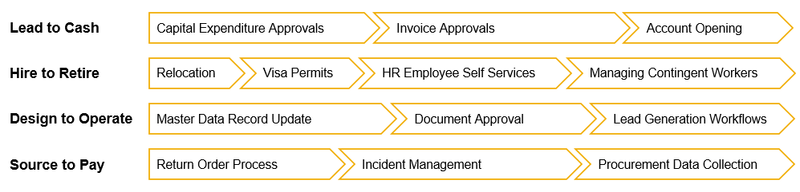
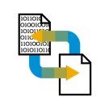
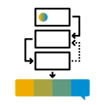

SAP Process Automation use cases
Automate manual, repetitive tasks
“Lights-out” automation of high-volume process steps
Automatically aggregate data from multiple systems
Digitalize manual & semi-automated processes
Extend and adapt standard application flows
Automate end-to-end cross-application workflows

Slide 7
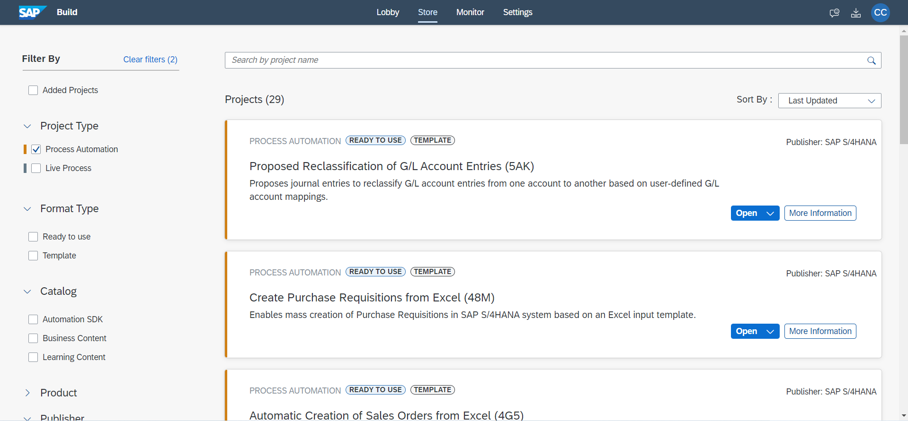
SAP S/4HANA Cloud Out-of-Box Prebuilt Content

Slide 8



SAP Process Automation A simpler and faster way to enhance business efficiency and agility with confidence
Build with Simplicity
Automate Faster
Operate Confidently
Simplify automation with visual drag-and-drop tools and industry specific content
Automate faster with business context in a unified workflow management and robotic process automation solution
Operate confidently on a trusted, enterprise-grade multi-cloud platform
Notes:
Simplify automation with visual drag-and-drop tools and industry specific content
Empower business users to build workflows and automate tasks with an intuitive, easy to use and powerful no-code experience
Enable business users and developers to collaborate on projects with the tools that best fit their respective skill sets
Jumpstart projects using the broadest set of pre-built industry content and use cases for SAP applications
Automate faster with business context in a unified workflow management and robotic process automation solution
Access workflow management and task automation capabilities in a single tool
Leverage built-in AI-capabilities for recommendations, document processing and more.
Instantly use data from SAP applications without losing its business context and meaning
Operate confidently on a trusted, enterprise-grade multi-cloud platform
Utilize your cloud of choice while interoperating with your existing IT landscape
Safeguard operations with centralized governance, testing and monitoring capabilities.
Ensure compliance and deploy with trust as the service is designed to meet stringent enterprise-class SLAs, compliance and privacy regulations.

Slide 9
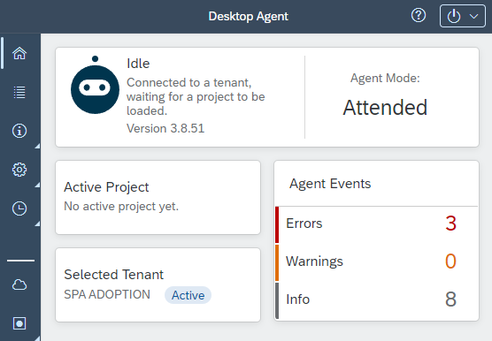
Agent 3 New!!
Key Feature:
Smart Update
Simplified first download
Faster project switching
Modern Technology and Architecture
Easy UI for Version Management
RDP Manager

Slide 10
Extend SAP S/4HANA Cloud Pre-built Content with Workflow

Slide 11






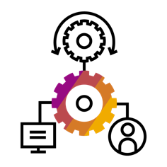


Accelerate business transformation with prebuilt content packages
Jump-start automation development while making use of best practices
Select from a wide variety of prebuilt, directly usable packages
across line of business
industries
shared functions
Content ranges from
templated automation (bots)
processes (workflows)
form templates
actions (called skills)
to complete automation packages combining artifacts
Automations
Line of business
Workflows
Industry
Dashboards
Forms
Shared services
Skills

Slide 12
Hands-on Exercise Flow
SAP S/4HANA Cloud
SAP Build Process Automation
Register and configure agent
Bot Execution to trigger Purchase Requisition Creation from Form
Create Purchase Requisitions from Excel (48M)
Extend bot with Workflow (Approval Process)
Set-Up
Download
Extend
Deploy and Execute
Condition - Purchase Requisition Value >=100

Slide 13
Hands-on Exercise Flow
SAP S/4HANA Cloud
Exercise 0
Exercise 1
Exercise 2
SAP Build Process Automation
Register and configure agent
Bot Execution to trigger Purchase Requisition Creation from Form
Create Purchase Requisitions from Excel (48M)
Extend bot with Workflow (Approval Process)
Set-Up
Download
Extend
Deploy and Execute
Condition - Purchase Requisition Value >=100

Slide 14
Hands-on Exercises Logon Credentials
Exercise 0: SAP Build Process Automation
→ Google Chrome: Group Number as on the Post-it
→ URL:https://dt262-9vbrkgdy-applicationdevelopment.lcnc.cfapps.us10.hana.ondemand.com/lobby
Login with user DT262_0XX Password: TechEd22$
Exercise 2: Release, Deploy and Execute the Business Scenario
SYSTEMURL_ODATA:- https://my401669-api.s4hana.cloud.sap/sap/opu/odata/sap
S4H_USER_AUTH_48M:
login - DT262_USER
password - WelcomeDT262TechEd_22
EMAIL_RECIPIENTS_48M: Email recipient. Put some fake address, as we have disabled the email function
Session also available in SAP Discovery Center:
https://discovery-center.cloud.sap/missiondetail/4018/4222/
HAVE FUN! :-)

Slide 15
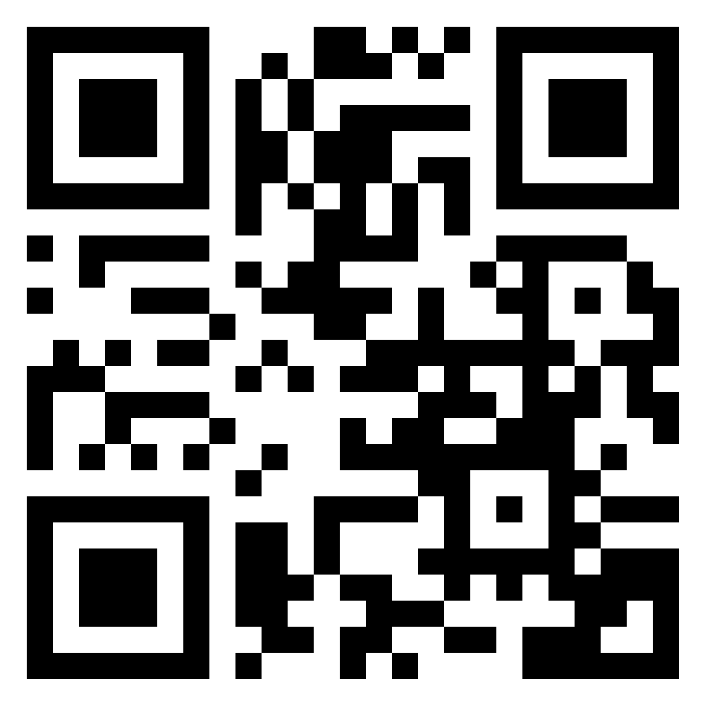
Session Survey- Tell us how we did!
Please take a moment to tell us what you thought of this session – scan the QR Code to complete the session survey, and have your voice heard.
Amitha Kamath
amitha.kamath@sap.com
Chuck Chen
chuck.chen@sap.com
Mathias Rup
Mathias.rup@sap.com

Slide 16


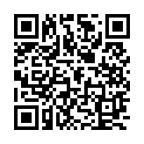

Collect a piece of SAP’s heritage!
SCAN ME!
To celebrate 50 years of SAP, SAP TechEd participants can collect unique NFTs that reimagine some of SAP’s most iconic moments.
Claim your NFT by scanning the QR code or using the 4-digit code.
C A Q N
https://50years.nft.net.sap

Slide 17
Additional TechEd sessions
Improve, Automate and Extend Business Processes with Low-Code/No-Code Tools
Speed Business Transformation with App Development and Automation Tools
Extend and Improve Standard Application Processes Easily
Automate Arvato Systems - Bertelsmann Using SAP Process Automation
Build Process Automations and Extensions to SAP Solutions
Build Robust Apps Enhanced with Process Automation and Low-Code Tooling
Get More from Your Bots: It's SAP Process Automation
Automate Your Invoice Processing with SAP Process Automation
Execute Bots in SAP S/4HANA Cloud with SAP Process Automation
Driving Intelligent Automation with SAP Integration Suite

Slide 18




Open new career opportunities Join the community of people with skills for the future
Mandatory Slide - Talk track available in the notes
Check learning.sap.com/teched to benefit like other certified experts:
61%
Get promotions¹
91%
>71%
Increase
Increase
confidence in abilities¹
problem-solving skills²
Become an SAP solution expert – now as easy as 1,2,3 in one place:
Expand your conference experience:
Follow expert-led learning journeys and live sessions for various development roles to upskill and prepare for certification
Benefit from the event-exclusive certification offer
FREE
Connect with experts, share your knowledge, expand your network, and collaborate with peers in SAP Community
Network with other participants in the group for SAP TechEd and join the SAP Learning Groups to get your learning questions answered
FREE
SAP TechEd OFFER
FREE
1. Pearson VUE’s Latest “Value of IT Certification” Study Highlights Benefits of IT Certification in Challenging Times,” Pearson Education Inc., May 25, 2021.
2. Chuck Cooper, Why Get IT Certified? The Value of IT Certification: An IT Certification White Paper, IT Certification Council, March 2021.
Notes:
Here are some great learning offerings to compliment your conference.
You can prepare for a certification in development roles with free SAP Learning Journeys and live learning sessions led by SAP experts
Save with an exclusive SAP TechEd certification offer that came in your SAP TechEd registration email
Connect with the experts, expand your network, and share your knowledge and experiences with others in the SAP Community
And network in a moderated SAP Learning Group to get your learning questions answered
Find all the great content at learning.sap.com/teched.

